Slide 1
Bell Activity 2, 3, and 4
Get notebook and textbook.
Write hw in planner:
HW#1 DUE FRIDAY!
Atomic Theory handout due Friday!
Answer the following question in COMPLETE, RESTATED sentences in your notebook:
BA #27 Compounds and Mixtures
What is the difference between a compound and a mixture?

Slide 2
Today’s Jobs!
Finish questions 1-7 on periodic table. 25 minutes only! Turn this in!!!!!!
As a group, finish questions 1-5 about your element. Every person helps find information while one of you writes it on a separate sheet of paper!
Sketch a rough draft of your atom. Make sure you know how many protons and electrons your atom has!

Slide 3
Bell Activity 6th
Get out supplies for ATOM BUILDING!!!!
Quickly and quietly get to your seat with your materials out.
Get out your research from yesterday and review QUIETLY with your group!
SHHHHHHHHHHHHH OR NO MODELS!!!!!!!!
☺

Slide 4
Let’s Build an Atom
Follow along with me as I read the red instruction sheet!
You have one hour to make something FANTASTIC!
The best ones will be on display in my classroom. Those hard working kiddos will receive a special surprise!

Slide 5
Bell Activity
Get notebook and textbook.
Get your finished models off of the counter and bring them to your table. Put them in the middle.
Write h/w in planner! QUIZ THIS WEEK!
Answer the following question in complete, restated sentences!
BA #23 Change
What is the difference between physical and chemical changes?

Slide 6
GATOR TIME
Get notebook and textbook! QUICKLY!
We are going to watch the movie you didn’t get to watch yesterday!
Sit QUIETLY and get out a pencil please! ☺

Slide 7
Notebook pg 13 the Periodic Table
Atoms- smallest particle from which all elements are made
Composed of subatomic particles:
Protons (positive charge), Neutrons (neutral charge) in the nucleus
Electrons (negative charge) floating around nucleus

Slide 8
Elements: combine in many ways to produce compounds that make up EVERY living and non-living thing
Periodic table: an arrangement of elements showing the repeating pattern of their properties
First created by Dmitri Mendeleev in 1869. He discovered a set of patterns that applied to all elements.

Slide 9
Grouped elements by:
similar chemical and physical properties (melting point, density, color, etc.)
Atomic mass- is the average mass of all isotopes for that element.
Isotope: different forms of the same element, different number of neutrons still the same element
Mendeleev arranged elements in order of increasing atomic mass

Slide 10
Reading the table:
Atomic Number: top corner, first piece of information, shows number of protons
Atomic/Chemical Symbol: in the middle, contain one or two letters, usually an abbreviation of the element name in English or Latin
Atomic Mass: bottom, average atomic mass (average because most elements exist in mixtures of isotopes, or different forms)

Slide 11
Pg 15 Using the Periodic Table
An element’s properties can be predicted from its location on the table
Periods= 7 rows, arranged in pattern from left to right
Left metals, center metalloids, right non-metals
Groups= 18 columns, also known as families
Pattern of properties repeat in each period so the elements in each group have similar characteristics

Slide 12
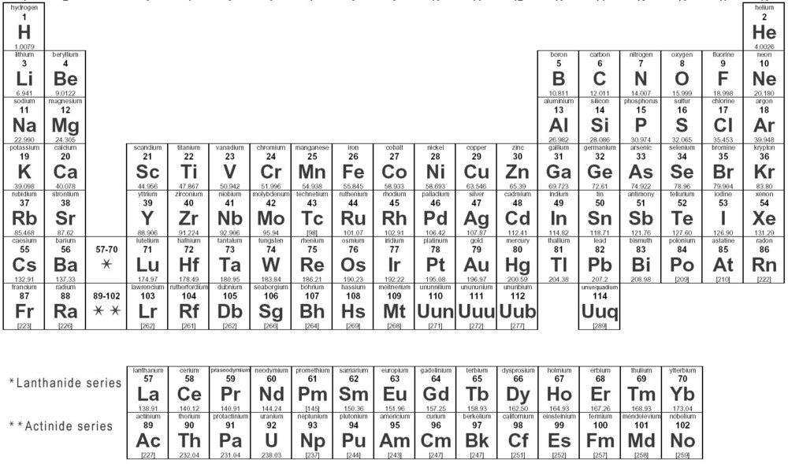
Periods= 7 rows, arranged in pattern from left to right
Left metals, center metalloids, right non-metals
Groups= 18 columns, also known as families
Pattern of properties repeat in each period so the elements in each group have similar characteristics
7
Periods
An element’s properties can be predicted from its location on the table

Slide 13
Periodic Table Project
Side one: Metals!
This side of your poster should include the chemical and physical properties of metals and the classifications of metal groups/families on the periodic table (alkali, alkaline earth, transition, mixed group, lanthanides/actinides, transuranium)

Slide 14
PERIODIC I-SPY
Words to use:
Group, family, period
Atomic mass, atomic number, atomic symbol
One person gives clues. Whoever guesses first gets to pick next!

Slide 15
Let’s Build an Atom!
A Quick Review:
What are subatomic particles?
Where are protons and neutrons found?
Where are electrons found?
What is the electric charge of a proton? Electron?

Slide 16
Notebook pg 60 Periodic Breakdown
On page 60 you are going to draw a diagram of the Titanium box on the periodic table. Make it exactly like the one in your planner!
Then, label the atomic number, atomic/chemical symbol, element name and atomic mass.
Color, label, and make it neat!

