Slide 2
Notebook page 3 Introduction to Matter
Matter= anything that has mass and takes up space
Can have many properties and characteristics (example: hard, soft, hot, cold, liquid, solid)
Substance- single kind of matter, “pure”, always has a specific make-up/composition

Slide 3
Element- a substance that cannot be broken down any further, the most simple substances
Elements are identified by their physical and chemical properties
Over 100 different elements are known today!
Atom- basic particle from which all elements are made
Elements have different properties because their atoms are different

Slide 4
Molecule- group of 2 or more atoms held together by a chemical bond to form a larger particle
Atoms of most elements can combine with others
When they combine they form a chemical bond, which is a force of attraction between two atoms

Slide 5
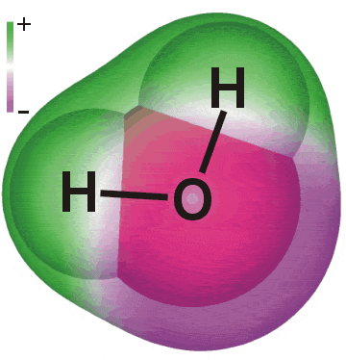
Elements can combine to form different elements, this is called a compound.
Compound- substance made of two or more elements that are chemically combined in a set ratio (Like water= two parts hydrogen, one part oxygen)

Slide 6
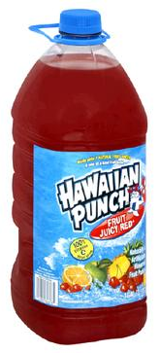
Mixtures- made up of two or more substances that are together in the same place, but their atoms are not chemically bonded.
2 types of mixtures
Homogeneous: substances in this type of mixture are so well blended that you cannot see the different parts
Example- Kool-Aid- made with Kool-Aid mix and water but you can’t tell them apart once you mix it

Slide 7
Heterogeneous: substances in this mixture can be separated easily, you can see different parts
Example- Trail mix- you can see the raisins, nuts, m&m’s

Slide 8
Notebook page 2 Matter Matters!
Complete Figure 2 on page 261, cut it out and put it on page 2
On the bottom half of the page make a chart like this one:
Give 3-5 examples of each type of mixture
HETERGENEOUS MIXTURE | HOMOGENEOUS MIXTURE

